Slide 1
Primary Data Collecting Primary Data by Communication
MKTG 302-01
Spring Semester, 2025
Scott Beck

Slide 2
Student Learning Objectives
By the end of this module you will be able to:
Define primary data,
Discuss Structure and watchouts when too much structure is employed, and
Differentiate between different methods of administering questionnaires.

Slide 3
What is Marketing Research?
Marketing research is the process of planning, collecting, and analyzing data relevant to a marketing decision.
Notes:
Notes:
Marketing research plays a key role in the marketing system. It provides data on the effectiveness of the marketing mix and insights for necessary changes.
Marketing research is a main data source for management information systems.

Slide 4
How to view Marketing Research
Marketing
Research
Primary Data
Secondary Data
Primary data is information that you collect specifically for the purpose of your research project.
Secondary data is information which has been collected in the past by someone else. reports.

Slide 5
Definition of Primary Data
Primary data are the data that you collect from customers, prospects, employees, the general public, or any other group that has the information you need.
Source: Brown, Suter, Churchill

Slide 6
Quick Definitions
Exploratory: Insights and Ideas
Descriptive: Quantify, measure, predict, establish relationships
Causal: Establish cause and effect relationships

Slide 7
Exploratory Research
Research conducted to gain ideas and insights to better define the problem or opportunity confronting a manager.

Slide 8


What do you think?
MadTree Brewing
Rhinegeist
Others

Slide 9
Product Packaging (Concept) Research
The packaging test is a study that allows knowing the strengths and weaknesses of a product’s packaging and the messages it conveys.
Source: Zinklar

Slide 10
Product Packaging (Concept) Research *
Advantages:
Validate your packaging proposal
Optimize your product
Differentiate yourself from the competition
Know consumer preferences
Minimize risks
Reinforce brand recognition
Source: Zinklar

Slide 11
Descriptive Research *
Descriptive research is defined as a research method that describes the characteristics of the population or phenomenon studied.

Slide 12
Descriptive….
Exploratory research is very flexible; descriptive research is MUCH more rigid
Descriptive research requires the clear specification of…
WHO, WHAT, WHEN, WHERE, WHY, and HOW
… before data collection can begin.

Slide 13
What is Survey Research? *
Survey research is the process of collecting data from a predefined group (e.g. customers or potential customers) with the ultimate goal of uncovering insights about your products, services, or brand overall.
As a quantitative data collection method, survey research can provide you with a goldmine of information that can inform crucial business and product decisions.
But survey research needs careful planning and execution to get the results you want.
Source: Qualtrics

Slide 14
Causal Research *
The purpose of causal research is to test cause and effect relationships:
X Y
condition X causes event Y
X =
Cause
Independent Variable
IV
Y =
Effect
Dependent Variable
DV

Slide 15
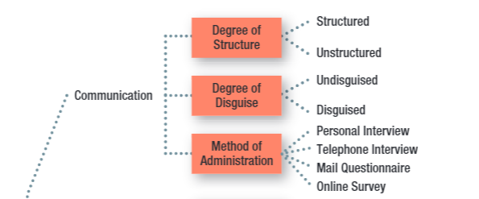
Key Issues for Collecting Information by Communication

Slide 16
Key Issues for Collecting Information by Communication
STRUCTURE *
The degree of standardization used with the data collection instrument.

Slide 17
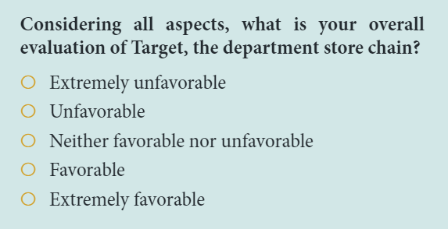
Key Issues for Collecting Information by Communication
FIXED-ALTERNATIVE QUESTIONS *
(also known as Close-Ended Questions)
Questions in which the responses are limited to stated alternatives.
© 2023 Cengage Learning. All Rights Reserved.

Slide 18
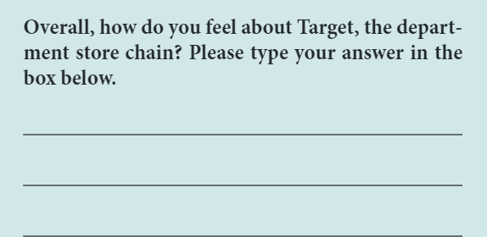
Key Issues for Collecting Information by Communication
OPEN-ENDED QUESTION *
A question in which respondents are free to reply in their own words rather than being limited to choosing from among a set of alternatives.
© 2023 Cengage Learning. All Rights Reserved.

Slide 19

High Structure: Advantages and Disadvantages
ATTRIBUTE Disadvantage Advantage
Ease of Administration
Ease of Coding and Analysis
Measure Reliability
Response Bias:
Forced choice
Omitted response
Precision of response

Slide 20
The Ethics of Disguise
DISGUISE *
The amount of knowledge people have about a study in which they are participating.
Disguise is especially useful when…
…knowing the purpose or sponsor is likely to bias respondents’ answers.
…re-creating the natural environment is necessary, particularly in experimental research.

Slide 21
The Ethics of Disguise *
Under the rights model of ethics, the use of disguise amounts to a violation of the respondent’s right to know.
DEBRIEFING: The process of providing appropriate information to respondents after data have been collected using disguise.

Slide 22
Primary Methods of Administration *
Personal Interviews
Telephone Interviews
Mail Surveys
Online Surveys

Slide 23
Personal Interview
PERSONAL INTERVIEW
Direct, face-to-face conversation between a representative of the research organization, the interviewer, and a respondent or interviewee.
Can be conducted in lots of different locations (including malls using mall intercepts)
Generally strong sampling control (including higher response rates)
Great flexibility, but higher levels of interviewer bias
Time- and cost-intensive

Slide 24
Survey Types
RANDOM-DIGIT DIALING (RDD)
A technique used in studies using telephone interviews, in which the numbers to be called are randomly generated.
IN-BOUND SURVEYS
A method of data collection in which respondents access a survey by telephone or on the Web to respond to survey items.

Slide 25
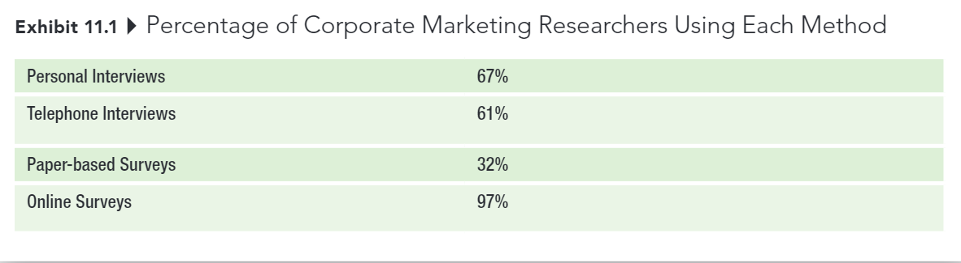
Survey Types
© 2023 Cengage Learning. All Rights Reserved.

Slide 26
Mail Survey
MAIL SURVEY
A survey administered by mail to designated respondents with an accompanying cover letter. The respondents return the questionnaire by mail to the research organization.

Slide 27
Mail Survey
Lower degree of sampling control (mailing lists often available, but no control over who completes survey, and often low response rates)
No interviewer bias and can offer anonymity, but less flexibility (no explanation or follow-up, no complex materials)
Lower cost than personal or telephone interviews

Slide 28
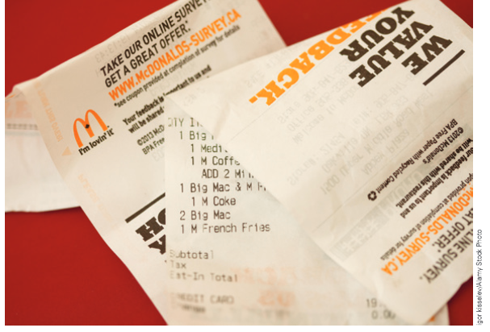
Online Survey
ONLINE SURVEY
A method of administration that relies on the Web for completing the survey.

Slide 29
Online Survey
Explosion in use over the past decade
Email lists and panels are readily available, but it’s difficult to know who you are really contacting; response rates are often very low
Good flexibility; visuals and complex material possible
Usually quick and inexpensive

Slide 30
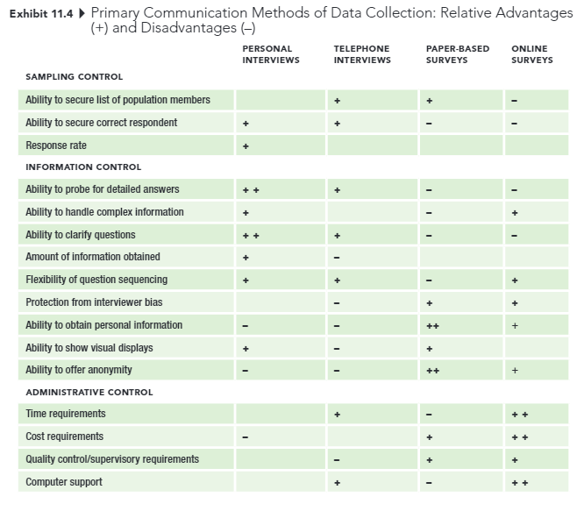
Online Survey
© 2023 Cengage Learning. All Rights Reserved.

Slide 31


